Slide 1
UCA Library Database
Bryan Harris, Dedrick Horton, Mary Johnson,
Hasani Mason,Jordan Storomo

Slide 2
Introduction
Used members(Created) combined with real books, movies, and journals in your very own UCA library
541 Tuples Used
Wide range of titles like Comedy, horror, and Romance
Notes:
Jordan
We used 541 tuples
Used members(created) combined with real books, movies, and journals in your very own UCA library

Slide 3
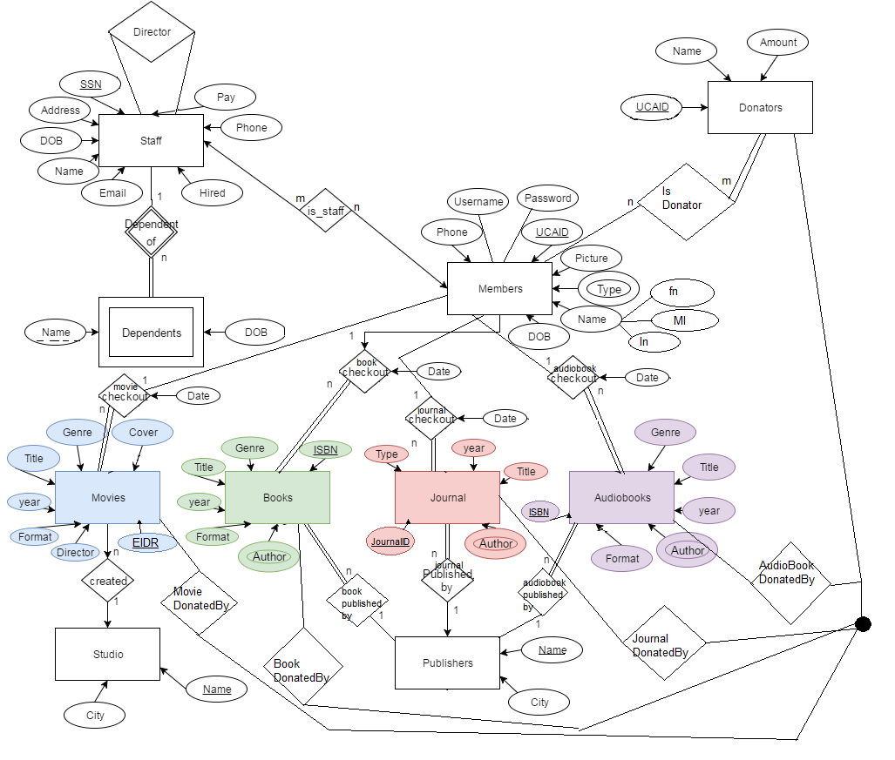
ER Diagram

Slide 4
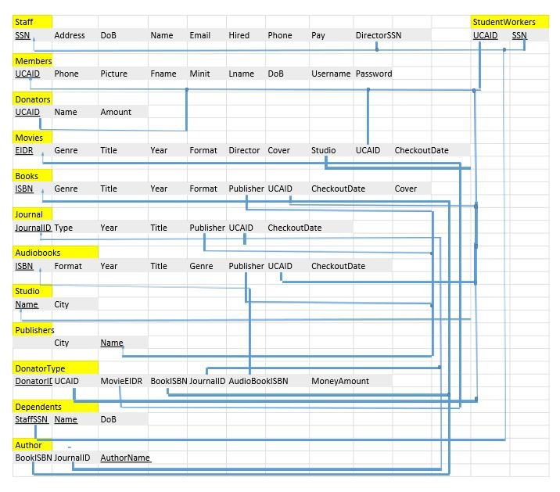
Database Scheme

Slide 5
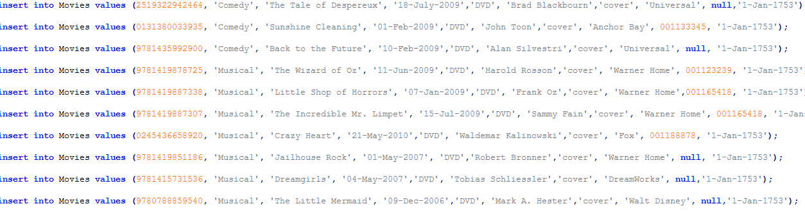
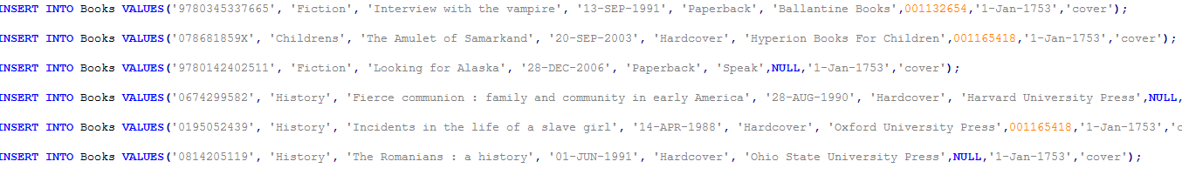
Insert statements

Slide 6
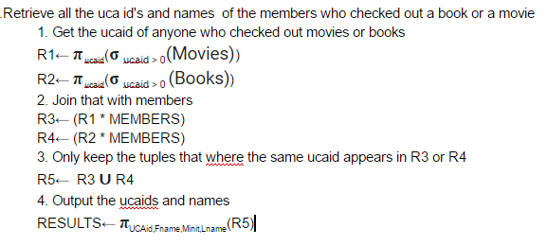
Relational Algebra Queries
Notes:
Bryan Harris

Slide 7
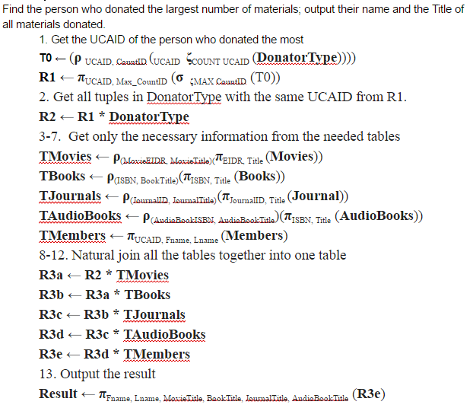
Relational
Algebra
Cont’d.

Slide 8
SQL Queries
Output the Title, Publisher, and City of all books.
CREATE TABLE P1 AS SELECT Title FROM Books;
CREATE TABLE P2 AS SELECT * FROM P1, Publishers WHERE publisher = name;
SELECT * FROM P2;
Notes:
Hasani

Slide 9
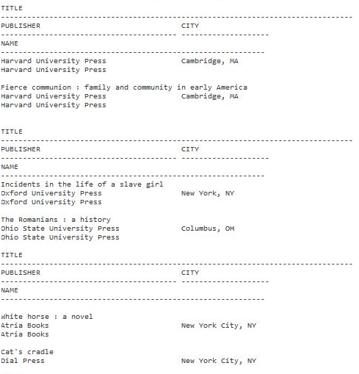
Notes:
Publisher’s result

Slide 10
Obtain the names of members who have checked out a movie whose studio is in California
CREATE TABLE P1
AS
SELECT name from studio WHERE city= 'California';
CREATE TABLE R1
AS
SELECT * FROM movies, P1 WHERE movies.studio = P1.name;
CREATE TABLE R2
AS
SELECT ucaid FROM R1 WHERE ucaid >= 0;
CREATE TABLE R3
AS
SELECT Lname, Minit, Fname FROM members, R2 WHERE members.ucaid=R2.ucaid;
select * from r3;
Notes:
Dedrick

Slide 11
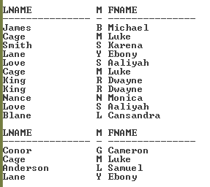

Slide 12
Conclusion

